Slide 1
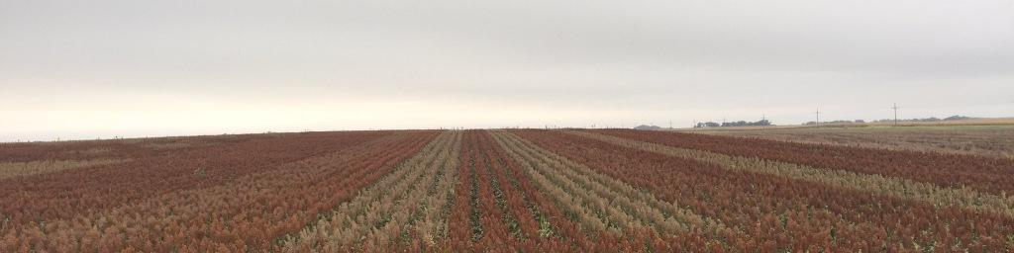
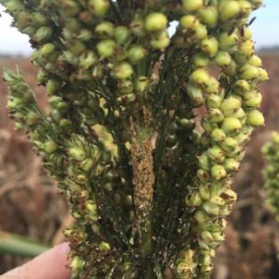
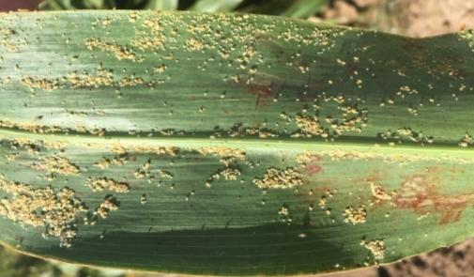
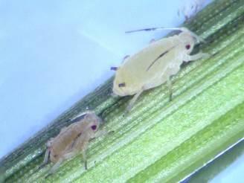
Sugarcane Aphid Management – 2017
Brent Bean
Photo: TAMU, Aherns

Slide 2
The United Sorghum Checkoff Program has committed close to $1 million on sugarcane aphid research and educational materials since 2015
This presentation summarizes what we have learned about sugarcane aphid and how it should best be managed
AMS approved

Slide 3
Presentation Outline
SCA biology
Tolerant hybrids
Effectiveness of seed treatments
Thresholds: Determining when to spray
  Scouting
  When to spray
  Susceptible vs tolerant hybrids
  Should spray threshold change with sorghum growth stage
Insecticide choices and rates
Controlling SCA in the presence of other pests (midge, headworms)
SCA management prior to harvest
Cultural and environmental factors that influence SCA control
Best management practices
AMS approved

Slide 4
Presentation Outline
SCA biology
Tolerant hybrids
Effectiveness of seed treatments
Thresholds: Determining when to spray
  Scouting
  When to spray
  Susceptible vs tolerant hybrids
  Should spray threshold change with sorghum growth stage
Insecticide choices and rates
Controlling SCA in the presence of other pests (midge, headworms)
SCA management prior to harvest
Cultural and environmental factors that influence SCA control
Best management practices

Slide 5
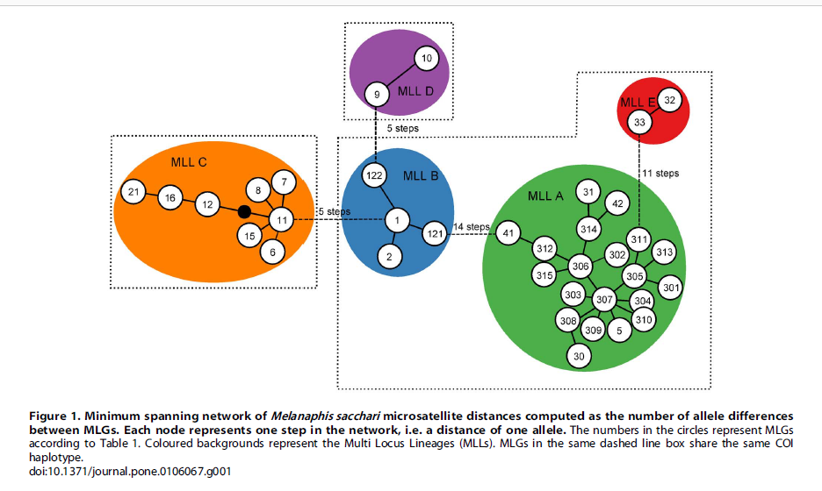
Origination of SCA in US Sorghum
East Africa, Indian Ocean, Caribbean and South America
Auburn – A Jacobson
US SCA in Sugarcane
US SCA in Sorghum Clonal lineage on sorghum associated with haplotypes from West Africa, Australia and China
AMS approved
Notes:
The sugarcane aphid that infests US sorghum is the same aphid that can be found in West Africa, Australia and China. It is not the aphid that has been present in US sugarcane for years. All research thus far has shown that the SCA in sorghum is the same throughout the US. Thus management of SCA should be similar across regions.

Slide 6
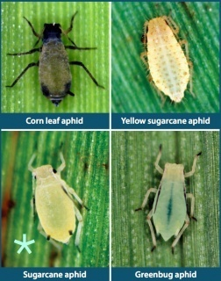
Aphids in Sorghum
SCA management starts with proper identification
A magnifying glass is typically required
SCA will be a pale yellow to sometimes tan color with black tipped feet and antennae and black cornicles (tail pipes)
KSU Scouting Card
AMS approved

Slide 7
SCA Reproduction on Sorghum
K Harris & X Ni USDA-ARS
SCA are born pregnant and begin giving birth 4 to 5 days after being born.
SCA can live about 28 days with peak reproduction over a 10 day period from 5 to 15 days after birth.
AMS Approved
Notes:
Graph is actually from Johnsongrass, but similar reproduction would be expected on grain sorghum. SCA average 8 to 10 offspring per day over a 7 day period and then reproduction tapers off. Over its potential lifespan the SCA averages 3 to 4 offspring per day.

Slide 8
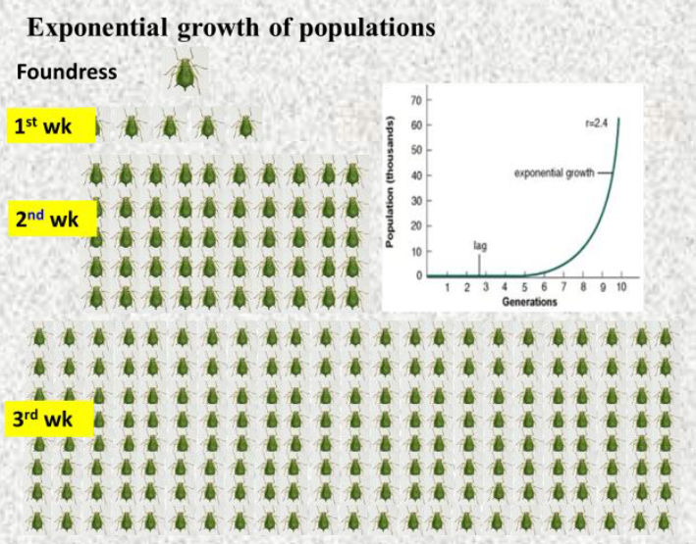
SCA Population can Increase very Fast
Source: TAMU
AMS Approved
Notes:
Once SCA is found in the field scouting should take place twice a week because of how fast threshold can be reached.

Slide 9
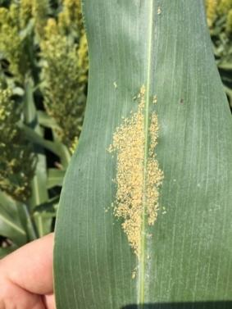
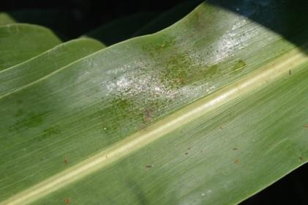
Colonies and Honeydew
SCA forms colonies on the underside of the leaf and as they feed they secrete a sticky honeydew material that drips onto the leaf below it.
AMS approved

Slide 10
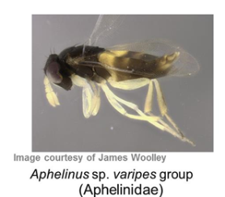
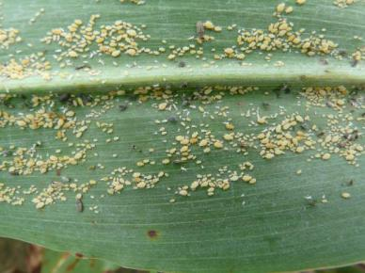
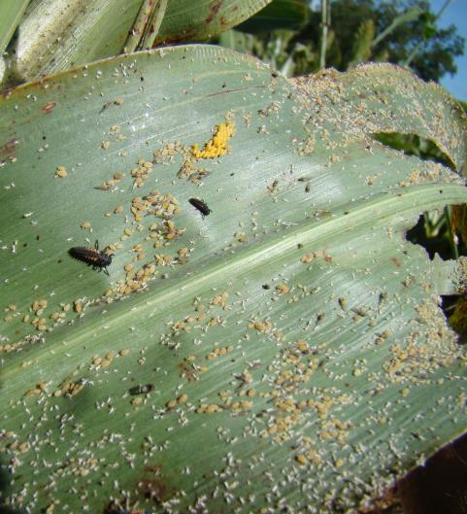
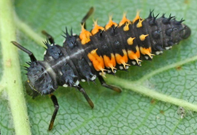

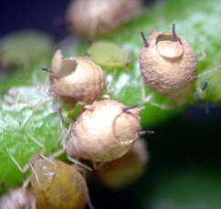
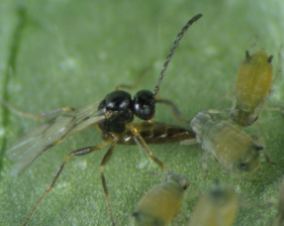
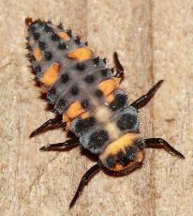
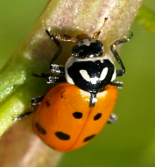
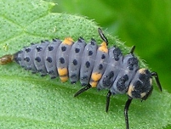
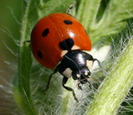
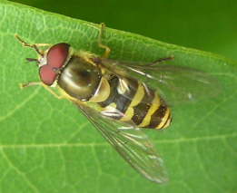
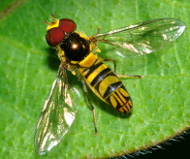
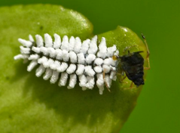
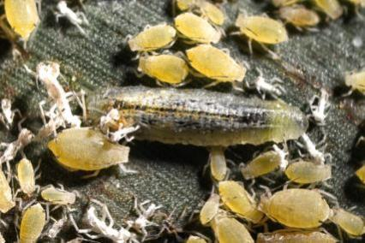
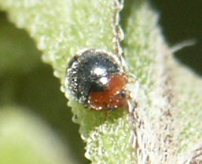
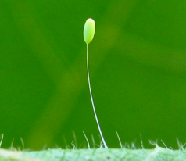
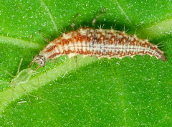
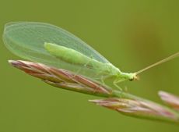
SCA Naturel Enemies
Photos: Andrew Sawyer, UGA; J.P. Michaud, Kansas State Univ.
Lysiphlebus testaceipes
Hover fly (syrphid) larvae & adult
Lady beetle larvae & adults
Left: Scymnus lady beetle
AMS Approved
Green lacewing
Notes:
Beneficials are VERY important in keeping SCA populations under control. This is why we do not recommend pyrethroids or Lorsban to control other pests when SCA is present.

Slide 11
Crop and Weed Hosts for SCA
Hosts
  Sorghum
  Johnsongrass
  Sudangrass
May survive but do not persist
  Corn
  Pearl Millet (Hybrid dependent)
  Sugarcane
  Crabgrass
  Barnyardgrass
  Napier grass
Will not feed on
  Wheat
  Rye
  Oats
  Switchgrass
G. Wilson & D. Kerns, LSU
AMS Approved
Notes:
On corn and sugarcane the aphid may survive for a few days but eventually dies.
On wheat the aphid will not feed on at all and does not survive.
Most pearl millets are resistant, but there are some exceptions.

Slide 12
Presentation Outline
SCA biology
Tolerant hybrids
Effectiveness of seed treatments
Thresholds: Determining when to spray
  Scouting
  When to spray
  Susceptible vs tolerant hybrids
  Should spray threshold change with sorghum growth stage
Insecticide choices and rates
Controlling SCA in the presence of other pests (midge, headworms)
SCA management prior to harvest
Cultural and environmental factors that influence SCA control
Best management practices

Slide 13
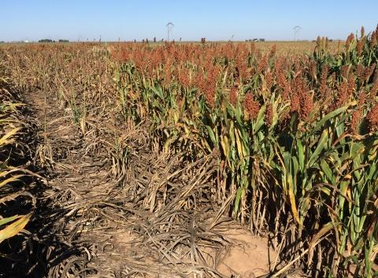
Tolerant Hybrids
Susceptible
Tolerant
AMS Approved
Notes:
Warner 7051. Example of tolerance in the field. Hybrids do make a difference!

Slide 14
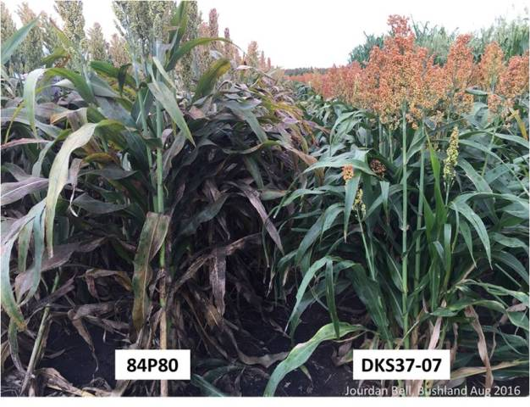
Tolerant Hybrids
There are clearly hybrids that have ‘some’ tolerance to SCA.
SCA typically multiplies much slower on these hybrids, but still may have to be sprayed!
Can buy you time.
AMS approved
Notes:
Tolerant hybrids are NOT immune from SCA and still may require and insecticide application and sometimes multiple applications.

Slide 15
Identifying Tolerant Hybrids
Louisiana – Kerns 2016
*
*
*
*
AMS approved
Notes:
Large differences in SCA count between the sprayed and nonsprayed indicate susceptible hybrids. *Indicates susceptible hybrid.
3707, 83P17, W844E, SP7715 are showing tolerance to SCA because of low SCA counts in both the sprayed and nonsprayed.
Notice SCA counts are still high in sprayed M75GB39, M77Gb52, 765B, REV9782 indicating SCA returned after the initial spraying.

Slide 16
Identifying Tolerant Hybrids
Louisiana – Kerns 2016
*
AMS approved
Notes:
Only 765B showed much of a difference between sprayed and nonsprayed. Probably has to do with level of SCA that was in the sprayed plots.

Slide 17
Identifying Tolerant Hybrids
D Buntin, UGA
AMS Approved
Notes:
430 is used as a susceptible check in trials. The 2783 line is where many of the commercial hybrids with tolerance get their resistance. A small difference between the blue and red bars indicates tolerance.

Slide 18
Identifying Tolerant Hybrids
D Buntin, UGA
AMS Approved
Notes:
Very important that hybrid is adapted to the area. In this case, even when KS585, SS800A and 3707 were sprayed the yield is not competitive with 73P17 in the Georgia trial.

Slide 19
2016 Hybrids Identified with
Some SCA Tolerance
Major Comp/Brands |  | Hybrid | Maturity
Pioneer |  | 83P17 | Med-Full
Pioneer |  | 83P56 | Med-Full
DeKalb |  | 37-07 | Med-Early
DeKalb |  | Pulsar | Med-Early
Sorghum Partners |  | SP 7715 | Med-Full
Sorghum Partners |  | SP 78M30 | Med-Full
Sorghum Partners |  | SP 73B12 | Med-Full
Richardson | RS260E |  | Med-Full
Richardson | Sprint W FG |  | Med-Early
Richardson | Jowar I |  | Full
Major Comp/Brands | Hybrid | Maturity
Richardson | Swift | V. Early
Alta | AG1201 | Early
Alta | AG1301 | Med-Early
Alta | AG1203 | Med-Early
Mycogen | 627 | Med-Early
Mycogen | 1G688 | Medium
B&H Genetics | BH 4100 | Medium
B&H Genetics | BH 3400 | V Early
Warner Seed | W-844-E | Med-Full
Warner Seed | W-7051 | Med-Full
Golden Acres | 3960B | Med
AMS Approved
Notes:
Only listing those hybrids that we believe have tolerance at least as good as 37-07. Most of these have also been confirmed by third parties.
Some companies are listing a few hybrids as moderately tolerant. These are not included in this list.
There are also a few regional brands that have tolerance that are not listed.
A list of tolerant hybrids for 2017 will be published soon.

Slide 20
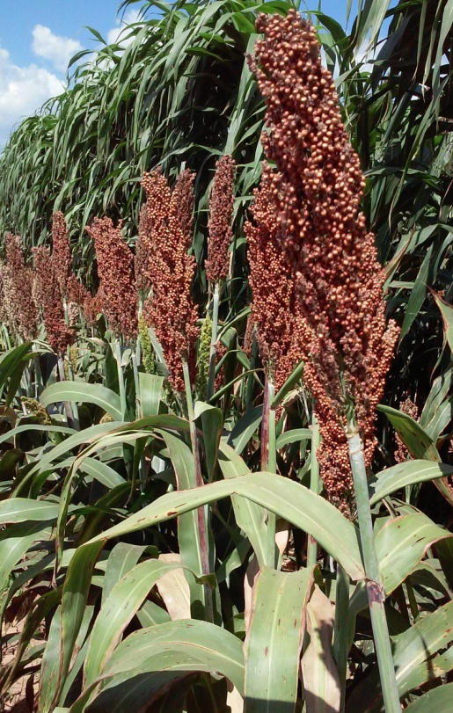
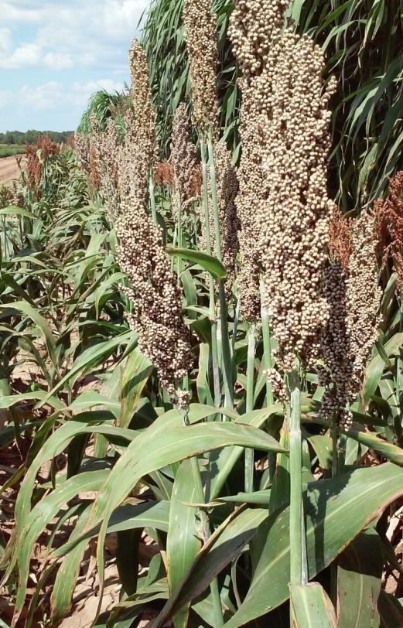
New Resistant Lines from TAMU
Other universities
and USDA-ARS are
releasing SCA resistant
lines.
Companies also have identified lines with resistance.
Tx3409/Tx2783
Tx3408/Tx2783
AMS Approved
Notes:
Universities, USDA-ARS and seed companies are working hard to develop new hybrids with strong resistance to sugarcane aphid.

Slide 21
Presentation Outline
SCA biology
Tolerant hybrids
Effectiveness of seed treatments
Thresholds: Determining when to spray
  Scouting
  When to spray
  Susceptible vs tolerant hybrids
  Should spray threshold change with sorghum growth stage
Insecticide choices and rates
Controlling SCA in the presence of other pests (midge, headworms)
SCA management prior to harvest
Cultural and environmental factors that influence SCA control
Best management practices

Slide 22
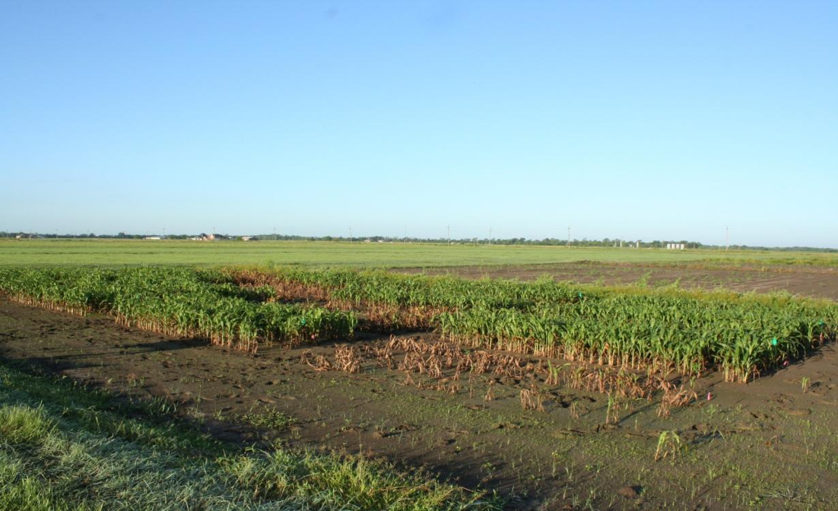
Seed Treatments for SCA Control
No Seed treatment
AMS approved
Photo: Mo Way, TAMU
Notes:
Dead sorghum plots did not have a seed treatment. Expect seed treatments to give approximately 40 days of SCA control.

Slide 23
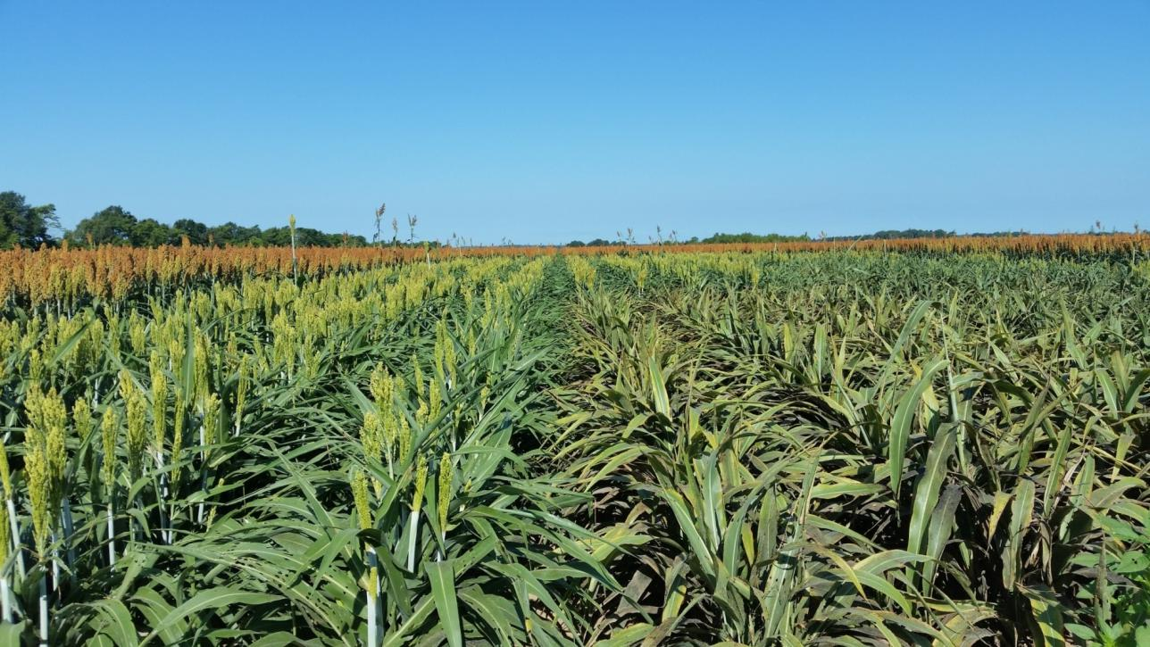
Seed Treatments
Photo: AR, Nick Seiter
AMS Approved
Notes:
Seed treatments make a difference.

Slide 24
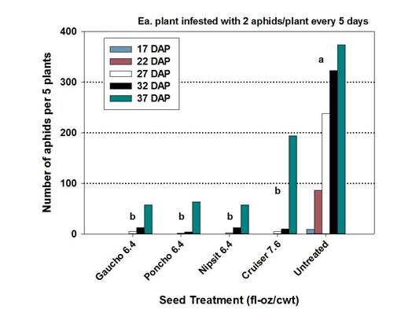
2015 Seed Treatment Trial
D. Kerns, LSU, Growth Chamber
AMS Approved
Notes:
2015. LSU-Kerns, work in growth chamber. Gaucho, Poncho, Nipsit and Cruiser all worked equally well.
Definitely providing control for 32 DAP. Beginning to break at 37 DAP.

Slide 25
2016 Seed Treatment Trial
AMS approved
Notes:
Good control in Texas trial for 38 days after planting with Poncho, Cruiser and Gaucho.

Slide 26
2016 Seed Treatment Trial
AMS approved
Notes:
49 days of control with Gaucho, Poncho and Cruiser.

Slide 27
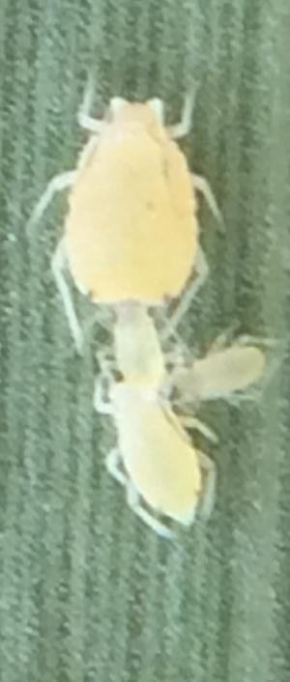
Seed Treatment Conclusions
All neonicotinoid seed treatments offer good early-season protection from SCA
Residual activity will vary, but expect approximately 40 days of control
May delay or eliminate the need of an early season foliar insecticide
Especially important on late-planted sorghum
Seed treatments offer the benefit of controlling other early season insects beyond early SCA control
D. Kerns - LSU
AMS Approved
Notes:
All of the seed treatments that are commercially being used today are effective in giving early season SCA control.

Slide 28
Presentation Outline
SCA biology
Tolerant hybrids
Effectiveness of seed treatments
Thresholds: Determining when to spray
  Scouting
  When to spray
  Susceptible vs tolerant hybrids
  Should spray threshold change with sorghum growth stage
Insecticide choices and rates
Controlling SCA in the presence of other pests (midge, headworms)
SCA management prior to harvest
Cultural and environmental factors that influence SCA control
Best management practices

Slide 29
Scouting for
Sugarcane Aphid
As soon as SCA are discovered in a region, scouting of individual fields should occur once a week. Once discovered in a given field that field should be scouted twice a week.
The first sign of SCA may be isolated spots in the field with honeydew on the lower leaves.
Scout in as many areas of the field as possible, but at a minimum of four locations.
In each location in the field, check for SCA on 20 plants from both an upper and lower leaf.
AMS approved

Slide 30
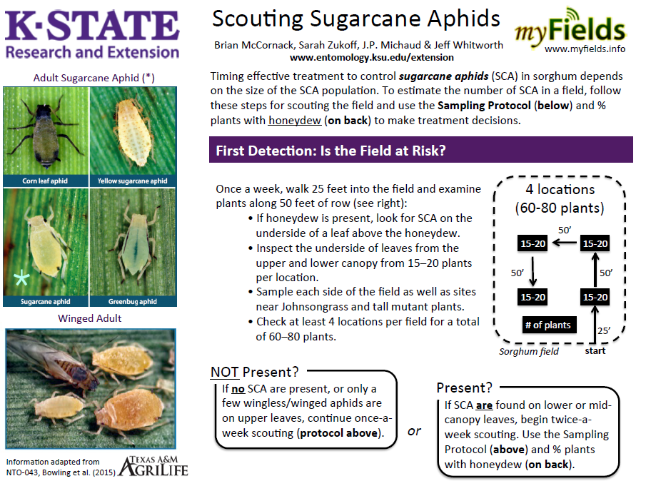
AMS Approved
Notes:
Extension services in various states have slightly different methods of scouting. Check with your extension service for specifics.

Slide 31
Threshold Determination for Sugarcane Aphid
Source, Michel Brewer, TAMU
AMS Approved
Notes:
Example of the kind of work various researchers are doing to determine threshold level.

Slide 32
Current Spray Thresholds
Determining when to spray varies slightly from state to state and sometimes even within a state.
Typically within any given field, any of the thresholds used will be effective and will trigger an insecticide application at about the same time.
Examples of thresholds:
  Spray when 25% of the plants are infested with a minimum of 50 aphids per leaf
  Spray when a field reaches a level of 50 to 125 SCA per leaf
  Spray when 20 – 30% (depending on growth stage) of plants are infested with localized areas of honeydew and established colonies are present
AMS approved
Notes:
Regardless of the specific threshold used, it is very important that the insecticide application take place as soon as possible once the threshold is reached. SCA numbers can explode in just a couple of days.

Slide 33
Susceptible vs Tolerant Hybrids
Arkansas - Seiter
AMS approved
Notes:
SCA multiplies much slower on tolerant compared to the susceptible hybrids

Slide 34
Threshold for Tolerant and Susceptible Hybrids Conclusions
Threshold for susceptible and tolerant hybrids should remain the same.
However, SCA will multiply much slower on tolerant hybrids, potentially eliminating the need for insecticide application or at a minimum delay when the application is needed.
Some tolerant hybrids appear to be able to withstand at least a moderate number of SCA without yield loss.
Scouting and timely application of insecticide is still critical for tolerant hybrids.
AMS approved

Slide 35
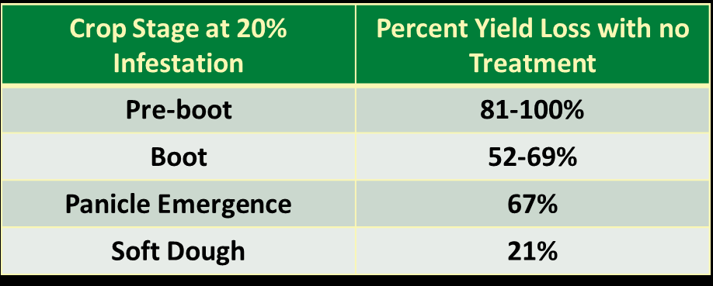
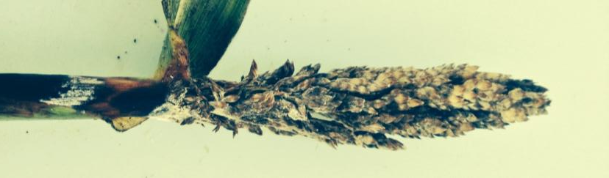
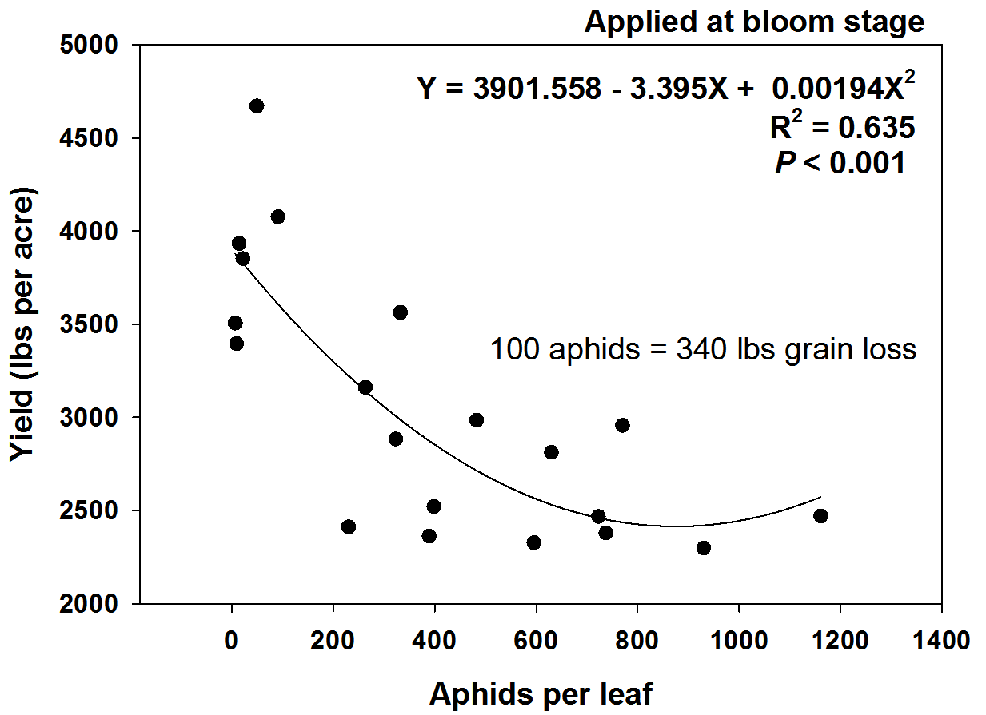
Potential yield loss
A. Catchot Mississippi State University
Kerns – Louisiana State University AgCenter, D. Kerns
AMS approved
Notes:
Yield loss can be severe if high infestations occur at or before flowering. Need additional data on yield loss, especially with late infestations.

Slide 36
SCA Infestation Occurs at 6 Leaf Stage - Georgia
Georgia - Buntin
6L (7/22)
8L (7/26)
94%
Yield
Loss
Bu/A
10L (8/1)
Boot (8/5)
Threshold (Aphids/Leaf)
AMS approved
Notes:
If SCA not controlled on pre-boot sorghum when threshold is reached, yield will be drastically reduced in just a few days. Yield was greatly reduced in just five days once SCA numbered 125 per leaf.

Slide 37
SCA Infestation Occurring at Boot - Georgia
Georgia - Buntin
Boot (7/22)
Boot (7/22)
Bu/A
90%
Yield
Loss
Boot (7/26)
Boot (8/1)
Threshold (Aphids/Leaf)
AMS approved
Notes:
Yield effected more at boot than milk stage (see next slide). There is also a planting date effect in Georgia. Data from this slide is from the second of three planting dates used to establish the trial. . Yield was greatly reduced if spray application was delayed only 4 days once threshold was reached.

Slide 38
SCA Infestation Occurring at Milk Stage - Georgia
Georgia - Buntin
Milk (7/22)
Milk (7/22)
SD (7/26)
SD (7/26)
Bu/A
25%
Yield
Loss
Threshold (Aphids/Leaf)
AMS approved
Notes:
Data from the first planting date in this trial. Yield is higher with this planting date than on the previous slide where sorghum was planted later. However, much less yield loss occurred when infestation occurred at the milk stage even at the higher SCA infestation levels. This means at later growth stages, growers should have more time to get their fields sprayed once the threshold has been reached before suffering a significant yield loss.

Slide 39
SCA Infestation occurring at the Boot-heading Stage –Kansas
Kansas - McCornack
(Flowering 9/5)
Boot-heading(8/30)
89%
Yield
Loss
Bu/A
(9/14)
Threshold (Aphids/Leaf)
AMS approved
Notes:
Low yielding trial mostly because of the planting date. Data from second planting date in Kansas. SCA infestation occurred at boot-heading stage. Yield severely reduced if not sprayed when 125 SCA/leaf by the flowering stage.

Slide 40
SCA Infestation occurring at the Hard Dough Stage –Kansas
Kansas - McCornack
Early Hard dough (8/30)
Hard Dough (9/5)
Hard dough (9/14)
Bu/A
Threshold (Aphids/Leaf)
AMS approved
Notes:
Different planting dates were used to generate SCA infestation at various growth stages. This data is from the first planting date and SCA infestation first occurred when sorghum was in the hard dough stage. No direct yield loss occurred at these infestation levels. However, SCA can still impact test weight and increase the potential for lodging.

Slide 41
SCA Infestation Occurring at Boot Stage - Arkansas
Arkansas - Seiter
Boot (7/18)
Boot (7/18)
Boot (7/20)
55%
Yield
Loss
Bu/A
Bloom (7/26)
Threshold (Aphids/Leaf)
AMS approved
Notes:
Planting dates were used to establish SCA infestation at different growth stages. In Arkansas, when infestation reached threshold at boot stage yield was significantly reduced if spraying was delayed for 8 days.

Slide 42
SCA Infestation occurring at Soft Dough Stage –Arkansas
Arkansas - Seiter
Soft Dough(7/15)
Soft Dough (7/20)
Hard Dough (8/2)
Bu/A
37%
Yield
Loss
Threshold (Aphids/Leaf)
AMS approved
Notes:
Planting dates were used to establish SCA infestation at different growth stages. In Arkansas, SCA infestations at threshold level did not reduce yield unless spraying was significantly delayed. In this case over two weeks.

Slide 43
Growth Stage Threshold Conclusions
Not enough data has been collected at this time to change the threshold level for insecticide application based on growth stage.
When SCA occurs at or before flowering, treatment application should occur as soon as possible or severe reduction in yield can occur.
At the late soft and hard dough stage more time can occur before treatment application without significant yield loss occurring.
Once the grain has reached physiological maturity, any yield loss from SCA infestation will be as a result of lodging and poor harvest efficiency.

Slide 44
Presentation Outline
SCA biology
Tolerant hybrids
Effectiveness of seed treatments
Thresholds: Determining when to spray
  Scouting
  When to spray
  Susceptible vs tolerant hybrids
  Should spray threshold change with sorghum growth stage
Insecticide choices and rates
Controlling SCA in the presence of other pests (midge, headworms)
SCA management prior to harvest
Cultural and environmental factors that influence SCA control
Best management practices

Slide 45
2015 Results
Average Number of SCA
(middle + flag leaf)
TN – Stewart, and Others
A
B
C
C
C
A
AB
B
B
C
A
B
B
B
B
9 Trials 12 Trials 9 Trials
AMS Approved
Notes:
2015 Results are an average of 9 to 12 trials across the US. Sivanto at 4 oz consistently gave the best results followed by Transform at 1 oz. Centric is NOT labled. Lorsban at 32 oz is labeled for SCA but clearly did not work was well as Sivanto or Transform.

Slide 46
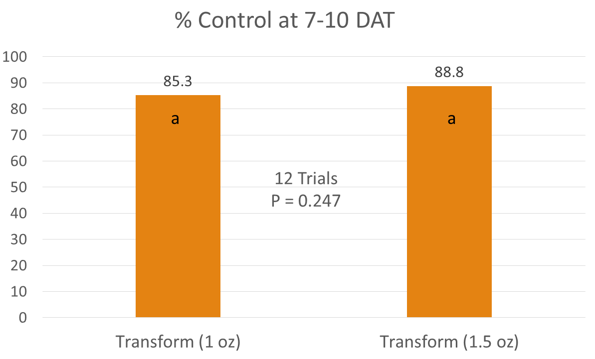
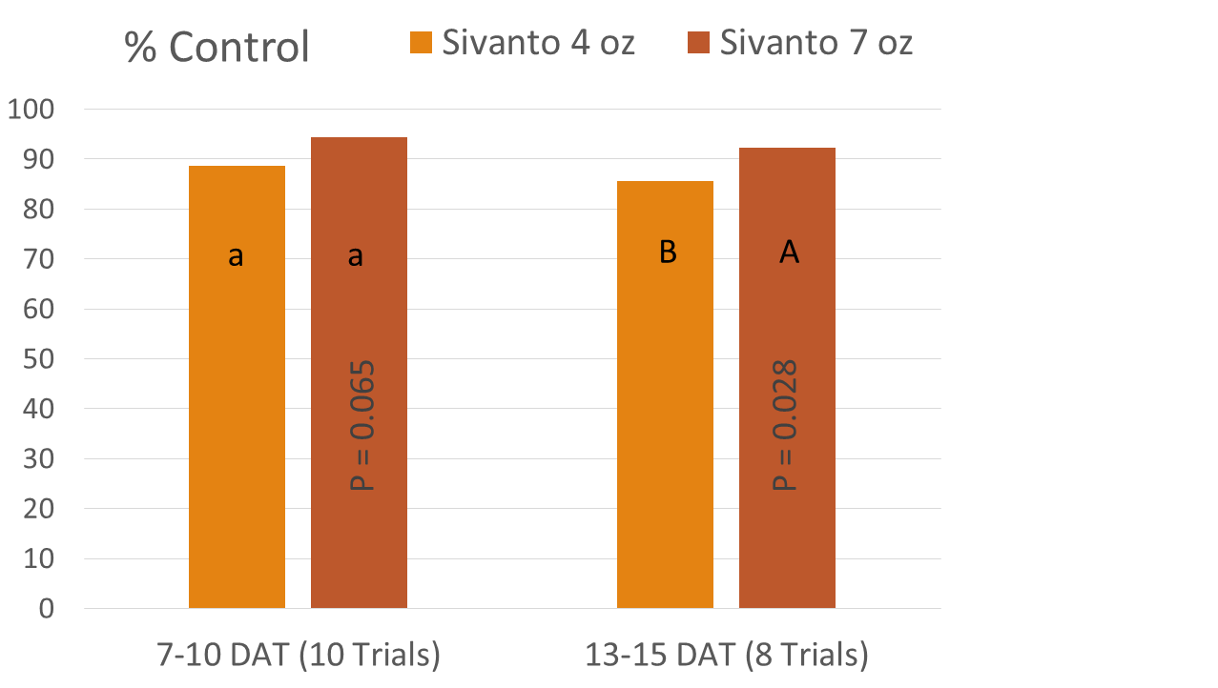
2015
Rate Response of
Transform and Sivanto
transform
Sivanto
AMS Approved
(8 oz in one test)
Notes:
Very little advantage in using higher rates of Transform or Sivanto. Under normal conditions the recommendation is to use 1.0 oz Transform or 4 oz Sivanto.

Slide 47
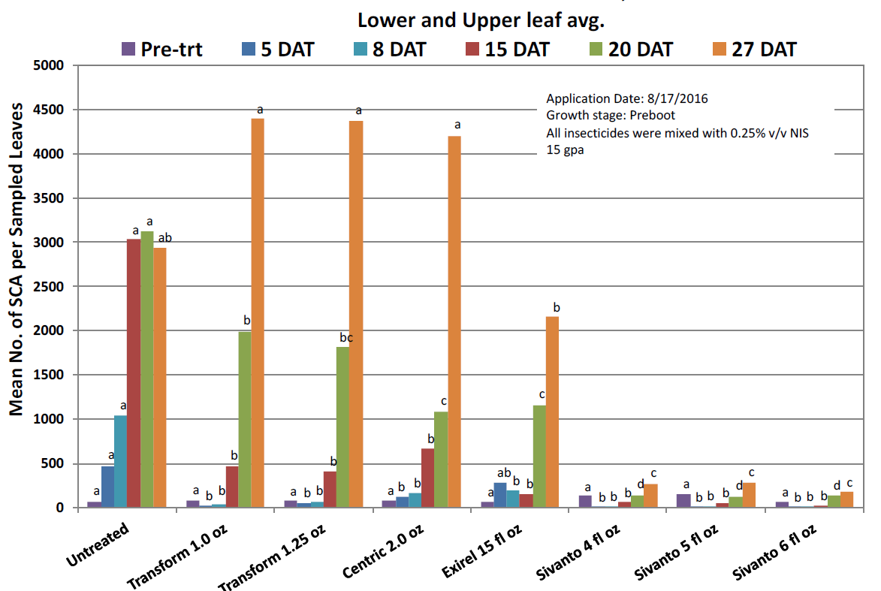
2016 SCA Insecticide Trial near Amarillo, TX
TAMU - Bynum
AMS approved
Notes:
Centric (thiamethoxam) and Exirel (cyantraniloprole or cyazypyre) are not labeled for use in sorghum. Transform control at both 1.0 and 1.25 oz rates began to break between 8 and 15 DAT. Sivanto at all rates gave the overall best and longest control.

Slide 48
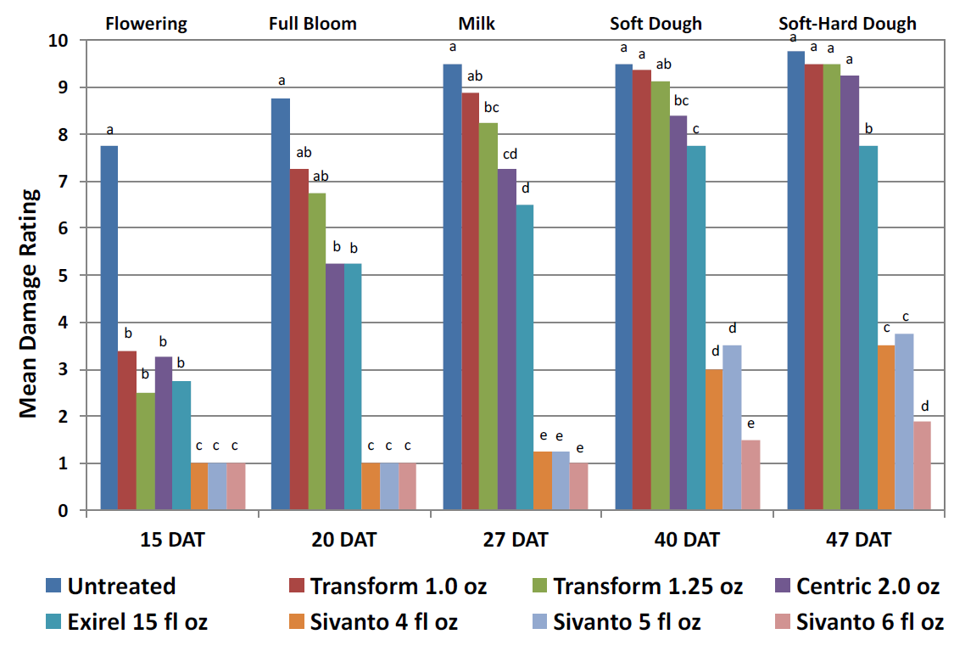
2016 SCA Insecticide Trial near Amarillo, TX
TAMU - Bynum
AMS approved
Notes:
Mean damage rating is an evaluation of plant damaged caused by SCA. These numbers reflect SCA control on the previous slide. However, notice that at 40 and 47 DAT the injury ratings go up with the Sivanto treatments, indicating that SCA were present in enough numbers to cause plant injury.

Slide 49
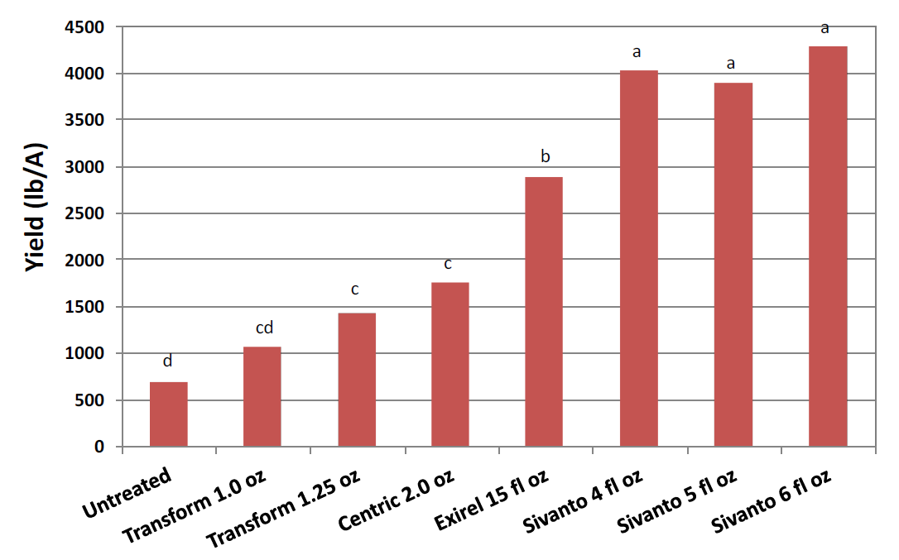
2016 SCA Insecticide Trial near Amarillo, TX
TAMU - Bynum
AMS approved
Notes:
Yield was best with the Sivanto treatments because of longer residual control. No difference in 4, 5 and 6 oz/A.
Centric (thiamethoxam) and Exirel (cyantraniloprole or cyazypyre) are not labeled for use in sorghum.

Slide 50
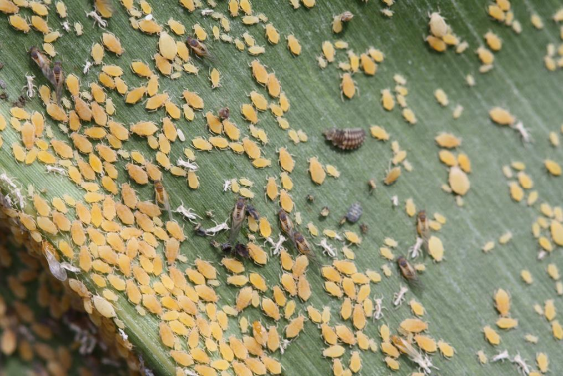
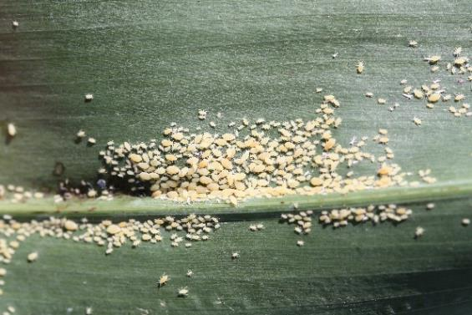
Evaluating Reduced Rates and Combinations of Transform and Sivanto - 2016
Treatments
Untreated
Transform 1.5 oz
Transform 0.75 oz
Sivanto 5 oz
Sivanto 2.5 oz
Transform 0.75 oz + Sivanto 2.5 oz
Transform 0.75 oz + Lorsban 16 oz
Sivanto 2.5 oz + Lorsban 16 oz
AMS approved

Slide 51
Evaluating Reduced Rates and Combinations- Arkansas
Arkansas - Lorenz
AMS approved
Notes:
In Arkansas excellent response to Transform and Sivanto at all rates tested.

Slide 52
Evaluating Reduced Rates and Combinations - Tennessee
TN- Stewart
Infestation occurred at heading
AMS approved
Notes:
In Tennessee all rates were effective. Sivanto appeared to be a little slower acting at the lower rate but still gave excellent control 13 DAT.

Slide 53
Evaluating Reduced Rates and Combinations - Tennessee
TN- Stewart
Infestation occurred pre-heading
S
S
S
S
S
S
Lorsban (16 oz), Dimethoate 4EC (16 oz), Pyreth (Mustang Max, 3.2 oz)
AMS approved
Notes:
The ‘S’ are all of the treatments that included Sivanto, all others included Transform. Notice that the worst Sivanto treatment was when it was mixed with a pyrethroid. Sivanto gave better control regardless of rate or tank mix than Transform in this test. Lorsban in the mix DID NOT HELP. Although not shown, Sivanto was still giving excellent control 25 DAT (personal communication

Slide 54
Evaluating Reduced and Combinations - Georgia
GA - Buntin
Infestation occurred at flowering
S
S
S
S
S
Lorsban (16 oz), Pyreth (Karate Z, 1.92 oz)
AMS approved
Notes:
Data is an average of 4 rating dates. The ‘S’ are all of the treatments that included Sivanto, all others included Transform. Notice that the worst Transform treatment was when it was mixed with a pyrethroid. Sivanto gave better control regardless of rate or tank mix than Transform in this test. Lorsban in the mix DID NOT HELP.

Slide 55
Evaluating Reduced Rates and Combinations - Oklahoma
OK - Zarrabi
SCA infestation occurred flowering
AMS approved
Notes:
In Oklahoma the lower rates of Sivanto and Transform were just as good as the higher rates used. Lorsban DID NOT help in control. All treatments applied without surfactant.

Slide 56
Evaluating Reduced Rates and Combinations – South Carolina
Clemson – Reay-Jones
SCA infestation occurred at flowering
S
S
S
S
S
Lorsban (16 oz), Pyreth (Bifenthrin 2E, 5 oz)
AMS approved
Notes:
The ‘S’ indicates the treatment included Sivanto, all others are Transform containing treatments. At Clemson, Transform actually performed as good or better than Sivanto. Lorsban in the mix DID NOT help, and actually resulted in less SCA control.

Slide 57
Yield (bu/A) of Standardized Efficacy Trials (2016)
Reay-Jones, Lorenz, Stewart, Zarrabi
Treatment (Oz/Acre) | SC | AR | TN-1 | TN-2 | OK | Average
Untreated | 42.6 a | 39.3 b | 38.1 c | 8.8 c | 45.6 b | 34.9 C
Transform (1.5) | 49.1 a | 41.3 b | 79.6 ab | 38.3 b | 80.9 a | 58.2 BC
Transform (0.75) | 48.5 a | 44.8 ab | 64.2 b | 29.4 b | 75.9 a | 52.4 C
Sivanto (5.0) | 52.9 a | 57.5 a | 75.5 ab | 82.8 a | 83.7 a | 70.9 AB
Sivanto (2.5) | 67.7 a | 57.0 a | 83.1 a | 73.8 a | 76.3 a | 72.1 AB
Transform (0.75) + Sivanto (2.5) | 79.7 a | 49.3 ab | 87.7 a | 85.8 a | 85.7 a | 77.4 A
AMS approved
Significant effect of location on treatment response (P = 0.0046)
Notes:
Reduced rates of Transform and Sivanto had little effect on sorghum yield.

Slide 58
Use of Adjuvants with Transform Summary Across 4 Trials
2015. Lorenz, N. Seiter, and G. Studebaker, AK; R. Bowling, R. Villanueva – TAMU; A. Zarrabi,
T. Royer – OSU, D. Kerns – LSU, D. Buntin – GA, D. Kerns - LSU
AMS approved
Notes:
None of the adjutants tested added any significant control of SCA with Transform. Important to note that the untreated check had 660 SCA/leaf. SCA numbers ranged from 18 to 85 when treated with Transform with or without an adjuvant.

Slide 59
Use of Adjuvants with Sivanto Across 4 Trials
AMS approved
Lorenz, N. Seiter, and G. Studebaker, AK; R. Bowling, R. Villanueva – TAMU; A. Zarrabi,
T. Royer – OSU, D. Kerns – LSU, D. Buntin – GA, G
Notes:
None of the adjutants tested added any significant control of SCA with Sivanto. Important to note that the untreated check had 570 SCA/leaf. SCA numbers ranged from 1 to 10 when treated with Sivanto with or without an adjuvant.

Slide 60
Insecticide Selection and Rates Conclusions
  Sivanto and Transform provide similar control of sugarcane aphid through 10-14 days after application, but Sivanto provides longer residual activity.
  The 2.5 oz rate of Sivanto generally provided similar aphid control as did the 5 oz rate
  The 0.75 oz rate of Transform generally provided similar aphid control as did the 1.5 oz rate
  Mixing reduced rates of Sivanto and Transform was a good treatment but did not substantially improve control
  Adding other insecticides such as pyrethroids or Lorsban tended to hurt performance of Transform or Sivanto
  Important to note that the lowest labeled rate of Sivanto Prime is 4 oz/A and Transform is 0.75 oz/A
  None of the adjuvants tested added any control of SCA with Transform or Sivanto
AMS approved

Slide 61
Presentation Outline
SCA biology
Tolerant hybrids
Effectiveness of seed treatments
Thresholds: Determining when to spray
  Scouting
  When to spray
  Susceptible vs tolerant hybrids
  Should spray threshold change with sorghum growth stage
Insecticide choices and rates
Controlling SCA in the presence of other pests (midge, headworms)
SCA management prior to harvest
Cultural and environmental factors that influence SCA control
Best management practices

Slide 62
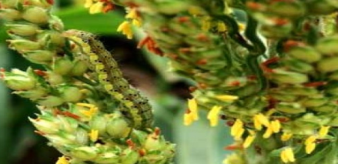
SCA/Headworm Treatments Tested in 2016
Trt | SCA insecticide | SCA Insecticide
1 | Untreated | Untreated
2 | Transform 1 oz/ac or | Pyrethroid (Baythroid XL 2.8 fl-oz or Karate Z 1.92 fl-oz/ac)
3 |  | Blackhawk 3.3 oz/ac
4 |  | Belt 3 fl-oz/ac
5 | Sivanto 4 fl-oz/ac | Prevathon 14 fl-oz/ac
6 |  | Lannate 2.4LV 16 fl-oz/ac
7 |  | Diamond 9 fl-oz/ac
OK location used Transform first application and Sivanto on a second application
AMS approved
Notes:
Belt is no longer being sold.

Slide 63
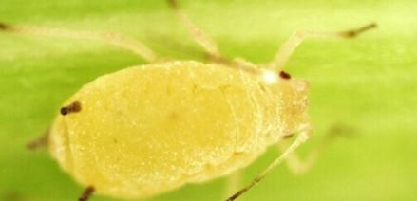
SCA Control with Transform applied with or without Other Insecticides
LA – Kerns and OK - Zarrabi
Oklahoma and Louisiana
Transform applied with various insecticides used for headworm control
AMS approved
Notes:
Pyrethroid (Baythroid or Karate Z) appeared to effect the control of SCA with Transform. Oddly, Belt, Blackhawk and Lorsban may have also effected SCA control with Transform. Prevathon and Lannate had no effect on SCA and control was best with these treatments. Belt is no longer being sold.

Slide 64
SCA Control with Sivanto Prime applied with or without other Insecticides
LA – Kerns and OK - Zarrabi
Oklahoma and Louisiana
Sivanto Prime applied with various insecticides used for headworm control
AMS approved
Notes:
Pyrethroids (Baythroid or Karate Z) did not control SCA when applied alone.
SCA numbers were slightly higher when pyrethroid was used with Sivanto. Definitely higher SCA numbers with Diamond.
All other treatments were very effective in controlling SCA.

Slide 65
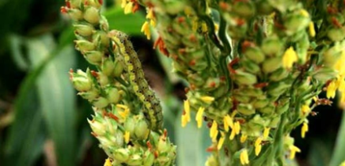
Headworm Control when various Insecticides Applied with
Sivanto or Transform
Kerns et al
AVG of Arkansas, Georgia, Kansas, Louisiana, Mississippi
AMS approved
Notes:
Did not matter if it was Transform or Sivanto, control was similar (data not presented). Blackhawk, Lannate and Prevathon gave the best headworm control.
At some locations, pyrethroids just do not work very well. May depend on which pyrethroid is used. Belt is no longer being sold.

Slide 66
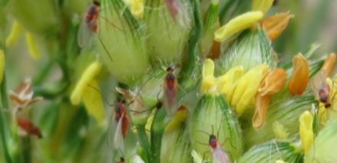
SCA/MidgeTreatments
Tested in 2016
Trt | SCA insecticide | Midge Insecticide
1 | Transform 1 oz/ac or | Untreated
2 |  | Pyrethroid (Baythroid XL 2.0 fl-oz or Karate Z 1.2 fl-oz/ac)
3 |  | Blackhawk 1.5 oz/ac
4 | Sivanto 4 fl-oz/ac | Lorsban 1 pt/ac or Lannate 2.4 LV 1 pt/ac
5 |  | Diamond 6 fl-oz/ac
AMS approved

Slide 67

Midge Control when various Insecticides Applied with Sivanto or Transform
Georgia - Buntin
Midge per 10 heads
AMS approved
Notes:
Midge pressure is low. One midge per head is what most entomologist used for a threshold. Karate Z was clearly the best treatment 3 DAT in this test.

Slide 68
Midge Control when various Insecticides Applied with Sivanto or Transform
Georgia - Buntin
No yield response
AMS approved
Notes:
Blackhawk appeared to give the best control based off of grain head damage. Blackhawk is also easy on beneficials.

Slide 69
Midge Control when various Insecticides Applied with Sivanto or Transform
Louisiana - Kerns
No yield response
AMS approved
Notes:
% injury of grain head. Blackhawk and Besiege (Prevathon + pyrethroid) gave the best control in LA.

Slide 70
Midge Control when various Insecticides Applied with Sivanto or Transform
Louisiana - Kerns
No yield response
AMS approved
Notes:
Diamond not working very well.

Slide 71

Managing SCA when Headworms are Present - Conclusions
Neither Transform nor Sivanto Prime appear to impact the efficacy of insecticides targeting headworm complex.
Pyrethroids may negatively impact SCA control achieved by Transform but did not appear to affect Sivanto Prime as much.
Previous research has shown SCA populations increase much faster when a pyrethroid is used in a field infested with SCA.
Blackhawk, Lannate and Prevathon all offered good headworm control.
Diamond was ineffective (timing issue?) and Pyrethroids were inconsistent (probably due to resistance in some area) in controlling headworms.
AMS approved
Notes:
Pyrethroids probably effected SCA control less with Sivanto Prime because Sivanto has longer residual.

Slide 72

Managing SCA when Midge are Present - Conclusions
Good sorghum midge tests are difficult to achieve.
Sorghum midge is probably over-emphasized as a pest (too many automatic sprays).
Were unable to assess midge/SCA treatment combinations.
Under low to moderate pest pressure, Blackhawk, Lorsban and Pyrethroids all appeared be effective in preventing midge injury.
Diamond was inconsistent; higher rates may be effective.
AMS approved

Slide 73
Presentation Outline
SCA biology
Tolerant hybrids
Effectiveness of seed treatments
Thresholds: Determining when to spray
  Scouting
  When to spray
  Susceptible vs tolerant hybrids
  Should spray threshold change with sorghum growth stage
Insecticide choices and rates
Controlling SCA in the presence of other pests (midge, headworms)
SCA management prior to harvest
Cultural and environmental factors that influence SCA control
Best management practices

Slide 74


SCA at Harvest
Sugarcane aphid at harvest does not directly effect yield, but can increase the percent moisture in the grain and effect harvestibility due to stickiness of the honeydew on the upper leaves or in the grain heads.
Photo: KSU
AMS approved

Slide 75

SCA management just before harvest - TX
Treated Oct. 28, 15 gpa
Sivanto and Defol mixed w/ 0.25% NIS
Malathion mixed w/ 1% COC
Glyphosate mixed with AMS – 12.75 lbs/100 gal
Bushland 2016,
Bynum
Defol = sodium chlorate
AMS approved
Notes:
Sugarcane aphids were very high on the upper leaves in this trial just prior to harvest. Glyphosate was ineffective in reducing SCA numbers on the leaf. Sodium chlorate lowered SCA numbers, but still relatively high. Malathion was effective in lowering the SCA number on the leaves 4 DAT but SCA numbers were back up 6 and 11 DAT. Sivanto at 2.5 oz was very effective at reducing SCA numbers on the leaves at 4, 6 and 11 DAT. It should be noted that the minimum labeled Sivanto rate is 4 oz. Similar results would be expected with 0.75 oz Transform.

Slide 76

SCA management just before harvest - TX
Bushland 2016,
Bynum
AMS approved
Rating Scale = 0 - none, 1 - few or light, …, 3 - moderate, …, 5 - heavy
Notes:
SCA in heads were rated on a scale of 0 to 5, with five being a very heavy infestation level. Glyphosate had no effect on SCA in the sorghum heads. Sodium Chlorate (Defol) actually caused an increase in SCA in the heads 4 DAT. Both Malathion and Sivanto Prime were effective in reducing SCA numbers in the heads. A rain event of 1.25 inches occurred after the 6 DAT rating and is the reason for lower SCA numbers 11 DAT.

Slide 77

SCA management just before harvest - TX
Bushland 2016,
Bynum
AMS approved
Rating Scale = 0 - none, 1 - few or light, …, 3 - moderate, …, 5 - heavy
Notes:
Sivanto Prime was most effective in reducing honeydew in the leaves closely followed by Malathion. Glyphosate ant Sodium Chlorate ( Defol) were ineffective in reducing honeydew in the heads. A rain event of 1.25 inches occurred after the 6 DAT rating and is the reason for lower honeydew 11 DAT.

Slide 78
SCA Management just Prior to Harvest - Arkansas
Nick Seiter, U of AR
4 Days after Treatment
AMS Approved
Notes:
2016 Data. Neither Roundup or Sodium Chlorate effective in reducing SCA in head 4 DAT. Sodium Chlorate alone was somewhat effective in reducing SCA numbers on flag leaf. Transform and Sivanto both did a good job. Suggest using the lowest labeled rate of Transform or Sivanto for controlling SCA near harvest.
Transform rate was 1 oz. Sivanto rate was 4 oz.

Slide 79
SCA Management just Prior to Harvest - Arkansas
Nick Seiter, U of AR
7 Days after Treatment
AMS Approved
Notes:
2016 Data. Very hesitant to recommend Roundup or Sodium Chlorate without the addition of insecticide for fear of moving SCA into heads. There were actually more SCA on Roundup treated sorghum 7 DAT compared to the untreated. With Sodium Chlorate SCA was greatly decreased on the flag leaf but increased in the heads. It is possible, that after 14 days, which is the labeled preharvest interval, SCA would have died on both the flag leaf and head. SCA numbers crashed in all treatments after the 7 DAT evaluation.

Slide 80
Pre Harvest Management Conclusions
Sivanto at 2.5 oz was effective in reducing SCA 73% 4, 6 and 11 DAT. Control would be expected to be better with a higher rate or lower SCA population. 4 oz is the lowest Sivanto Prime rate that is labeled. Transform at 0.75 oz would be expected to give similar control.
Malathion reduced SCA population 66% 4 DAT but only 9% 11 DAT. However, honeydew in head was significantly reduced on all rating dates.
Glyphosate had no effect on SCA population.
Sodium chlorate reduced SCA 50% on leaves but increased SCA in the heads.
It should be noted that the pre-harvest interval is 14 days for Sivanto (24c) and Transform, and 7 days for malathion and glyphosate. No pre-harvest interval is stated for sodium chlorate.
AMS approved

Slide 81
Presentation Outline
SCA biology
Tolerant hybrids
Effectiveness of seed treatments
Thresholds: Determining when to spray
  Scouting
  When to spray
  Susceptible vs tolerant hybrids
  Should spray threshold change with sorghum growth stage
Insecticide choices and rates
Controlling SCA in the presence of other pests (midge, headworms)
SCA management prior to harvest
Cultural and environmental factors that influence SCA control
Best management practices

Slide 82
Cultural and Environmental Effects on SCA
Planting Date is the cultural practice (with the exception of applying insecticides) that has shown to have the largest impact on managing SCA.
The effect of temperature, rainfall, relative humidity, day length, soil type and other environmental factors on SCA are unclear at this time.
AMS approved

Slide 83
Early vs Late Planting Date – Yield
TAMU Amarillo – Ada Szczepaniec
NO FOLIAR INSECTICIDE APPLIED
SCA numbers increased above threshold between Aug 10 and 14 when early planted sorghum was in the late soft dough stage and the late planted sorghum was flowering.
AMS approved
Notes:
3707 is a tolerant hybrid and 44-20 is susceptible. SCA infestation went over threshold level on August 14 with SCA counts of 600 in the susceptible DK 44-20 hybrid planted early. Seed treatment had more of an effect on the late planted sorghum since infestation occurred at an earlier growth stage.
Recommendation is to consider planting early with a tolerant hybrid with treated seed.

Slide 84
Early vs Late Planting Date – Yield
TAMU Amarillo – Ada Szczepaniec
FOLIAR INSECTICIDE APPLIED AT THRESHOLD
SCA numbers increased above threshold between Aug 10 and 14 when early planted sorghum was in the late soft dough stage and the late planted sorghum was flowering.
AMS approved
Notes:
3707 is a tolerant hybrid and 44-20 is susceptible. SCA infestation went over threshold level on August 14 with SCA counts of 600 in the susceptible DK 44-20 hybrid planted early. Recommendation is to consider planting early with a tolerant hybrid with treated seed.

Slide 85

Early vs Late Planted and Relative Insect Infestation
Trial near Plainview, TX
TAMU – B. Reed
AMS approved
Notes:
Hybrid P 8632. Early planting was last week of April to first week of May and the late planting occurred mid to late June. Early planting had fewer pests than the late planting except for spider mites. Midge historically arrives in the Plainview TX around August 4.

Slide 86

2016 Early vs Late Sorghum Planting - Yield
TAMU - Reed
AMS approved
Notes:
P 8632 hybrid with seed treatment. This was a lightly irrigated trial but severe bird damage reduced yield. Early planting was last week of April to first week of May and the late planting occurred mid to late June. Trial near Plainview, TX. No foliar insecticide application was made.

Slide 87
Planting Date Conclusions
Early planting is an avoidance method for managing sugarcane aphid in sorghum.
By planting early, sorghum may avoid sugarcane infestation altogether, or at least delay SCA infestation until the plant is at a later growth stage and thus reducing the effect on yield.
Shifting to an earlier planting should be considered for those regions where yield potential is relatively low and the expense of an insecticide application my may be prohibitive.
AMS approved

Slide 88
Best Management Practices for SCA
Control JG and other sorghum species around field
Consider planting tolerant hybrids adapted to the region
Use seed treatment for early aphid control
Plant early to avoid infestations early in the season
Scout early and often
Treat as soon as threshold is reached
Use the recommended insecticide, along with the lowest effective rate, applied in the recommended volume of water
Good spray coverage is key for SCA control
Avoid use of pyrethroids and other insecticides that are harmful to beneficials and may cause aphid numbers to increase rapidly
Use insecticide as needed for harvest-aid
AMS Approved

Slide 89

Brent Bean
USCP Agronomist
Email: brentb@sorghumcheckoff.com
Website: sorghumcheckoff.com

Slide 90
Disclaimer of Warranties/Accuracy and Use of Data
Although the data found here has been produced and processed from third party sources believed to be reliable, no warranty expressed or implied is made regarding accuracy, adequacy, completeness, legality, reliability or usefulness of any information. This disclaimer applies to both isolated and aggregate uses of the information. The United Sorghum Checkoff Program (“USCP”) provides this information on an "AS IS" basis. All warranties of any kind, express or implied, including but not limited to the IMPLIED WARRANTIES OF MERCHANTABILITY, FITNESS FOR A PARTICULAR PURPOSE, freedom from contamination by computer viruses and non-infringement of proprietary rights ARE DISCLAIMED.
Changes may be periodically added to the information herein; these changes may or may not be incorporated in any new version of the publication. If the user has obtained this information from a source other than USCP, the user must be aware that electronic data can be altered subsequent to original distribution. Data can also quickly become out-of-date. If the user finds any errors or omissions, USCP encourages the user to report them to the third party provider of the information.
It is recommended that the user pay careful attention to the contents of the information regarding relevance to the user’s region and/or management practices. USCP strongly encourages the user to contact their local chemical/seed distributor(s), extension and/or consultant regarding appropriate use or guidance and direction for the user’s specific operation and/or region.
Disclaimer of Endorsement
Regarding this information, USCP is a distributor of content supplied by third parties. Any opinions, advice, statements, services, offers, or other information or content expressed or made available by third parties, including information providers, users, or others, are those of the respective author(s) and do not necessarily state or reflect those of USCP. Reference herein to any specific commercial products, process, or service by trade name, trademark, manufacturer, or otherwise, does not constitute or imply its endorsement, recommendation, or favoring by USCP, and such reference shall not be used for advertising or product endorsement purposes.

